Slide 1

Industry Internship Project- SEE Presentation
Student Name: Amaresh Muddebihal
Student Registration No: 20030141IT015
Title in Internship:Cloud (AWS) Intern
Name of the Industry : Information Technology (IT) and Software Development Industry
Name and Designation of Industry Mentor: Rahul K /HR
Name and Designation of Mentor(University): Mr. Kalidass S / Assistant Professor, Department of CSE

Slide 2
Industry Internship Project- SEE Presentation
Cloud (AWS) Intern
Scalable Web Application Deployment
Information Technology (IT) and Software Development Industry
University Mentor
Mr. Kalidass S
Assistant Professor
Department of CSE
Industry Mentor
Rahul K
HR
hrteam.techplement@gmail.com
Presented by:
Amaresh Muddebihal
20030141IT015

Slide 3


Outline
Overview of the Industry
Project Overview
Methodology
Project Outcome / Results
Learning Experience
Challenges Faced
Future Enhancements
Conclusion
Significant Outcome(s)
References
Q&A

Slide 4
Overview of the Industry
About the Company (https://techplement.com/)
Techplement: A Software Development and Services Company.
Specializes in website development, DevOps, AWS cloud solutions, and educational development services.
Focus on innovation and delivering quality software to simplify complexities and drive success.
Roles and Responsibilities
Primary Focus: Scalable web application deployment using AWS.
Worked with Elastic Beanstalk, EC2, RDS, Auto-Scaling, and Load Balancer for robust application infrastructure.
Ensured high performance, reliability, and security of web applications.
Collaborated with the team to design, test, and implement solutions.

Slide 5
Project Overview
Project Description The project, Scalable Web Application Deployment, focused on developing a robust and dynamic application infrastructure using AWS services like Elastic Beanstalk, EC2, RDS, and Auto Scaling. The aim was to ensure the application could handle high traffic loads efficiently, maintain high availability, and provide seamless user experiences through automated scaling and load balancing mechanisms.
Project Relevance to the Organization This project aligns with Techplement's mission to deliver cutting-edge software solutions by leveraging cloud technologies. It demonstrates the company’s expertise in AWS-driven solutions, enhancing its reputation in scalable application deployment and cloud service management.
Key Objectives
To develop a high-performance and reliable web application infrastructure.
Automate resource scaling and load distribution to manage traffic efficiently.
Ensure data security and operational efficiency through AWS best practices.
Deliver a seamless, responsive user experience even during peak usage.
Expected Outcomes The project is expected to achieve a scalable, secure, and maintainable web application capable of handling fluctuating traffic demands while optimizing resource utilization and cost efficiency. It strengthens Techplement's service portfolio and showcases its capability in delivering modern cloud-based solutions.

Slide 6
Methods Used to Complete the Project
Requirement Gathering: Analyzed project requirements, including scalability, performance, and security needs, through discussions with stakeholders.
Infrastructure Planning: Designed a cloud-native architecture leveraging AWS services like Elastic Beanstalk, EC2, RDS, and Auto Scaling.
Development & Deployment: Utilized GitHub for version control and AWS Elastic Beanstalk CLI for seamless code deployment.
Testing & Optimization: Conducted rigorous testing for performance, security, and scalability to ensure the application met desired outcomes.
Monitoring & Feedback: Integrated AWS CloudWatch for real-time monitoring and analysis, ensuring continuous improvement.

Slide 7
Tools, Techniques, Software, or Frameworks Used
Cloud Platform: AWS (Elastic Beanstalk, EC2, RDS, S3, CloudWatch).
Programming Language: Python with Django/Flask for backend logic.
Version Control: GitHub for collaborative development and source control.
Monitoring: AWS CloudWatch for tracking performance metrics.
Security Management: AWS Secrets Manager and IAM for secure credential and resource access control.
Automation: AWS Auto Scaling for resource management during traffic fluctuations.

Slide 8
System Architecture
Frontend: User interface for interacting with the application.
Application Layer: Deployed on AWS Elastic Beanstalk with auto-scaling EC2 instances to handle backend processing.
Database Layer: Amazon RDS for secure and scalable database management.
Storage: AWS S3 for storing static assets like images and documents.
Load Balancer: AWS Elastic Load Balancer to distribute traffic across instances.
Key Features:
High availability with multi-AZ setup for RDS.
Scalable infrastructure through Elastic Beanstalk and Auto Scaling groups.
Real-time monitoring using CloudWatch.

Slide 9
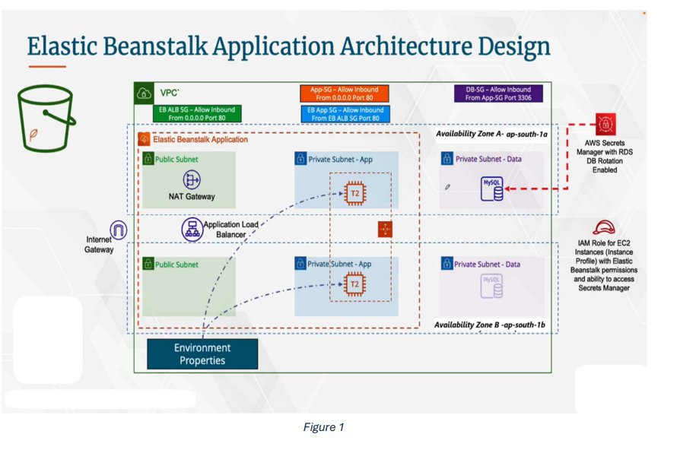
Elastic Beanstalk Application Architecture Design

Slide 10
Approach to Solving Project Tasks
VPC and Security Setup
Configured a Virtual Private Cloud (VPC) for secure networking.
Created security groups and IAM roles to ensure restricted and secure access.
Database Configuration
Launched an RDS instance within the VPC for low-latency communication.
Managed database credentials using AWS Secrets Manager.
Application Deployment
Deployed the application on AWS Elastic Beanstalk, which automated infrastructure provisioning.
Configured auto-scaling and load balancing to ensure availability.
Monitoring and Optimization
Set up CloudWatch alarms for critical performance metrics.
Optimized database queries and server configurations for improved responsiveness.

Slide 11
Project Results – Key Achievements
Performance Improvements: Achieved a 30% reduction in response times by optimizing server configurations and database queries.
Scalability: Successfully implemented auto-scaling infrastructure capable of handling traffic spikes up to 200% without downtime.
Deployment Efficiency: Reduced deployment time by 40% using automated workflows on AWS Elastic Beanstalk.
Security Enhancements: Secured all data transmissions with SSL/TLS, ensuring compliance with industry standards.
Sample Deployment Click here

Slide 12
Metrics and Statistics
System Metrics Post-Implementation:
Server Uptime: Maintained 99.99% availability with AWS Elastic Load Balancer and Auto Scaling.
Cost Efficiency: Achieved 25% cost savings by dynamically scaling resources based on real-time traffic.
Database Performance: Query execution time reduced by 50% with optimized indexing strategies.
Visualized Metrics:
Bar chart showing the response time before and after optimization.
Line graph illustrating traffic management during peak hours using auto-scaling.

Slide 13
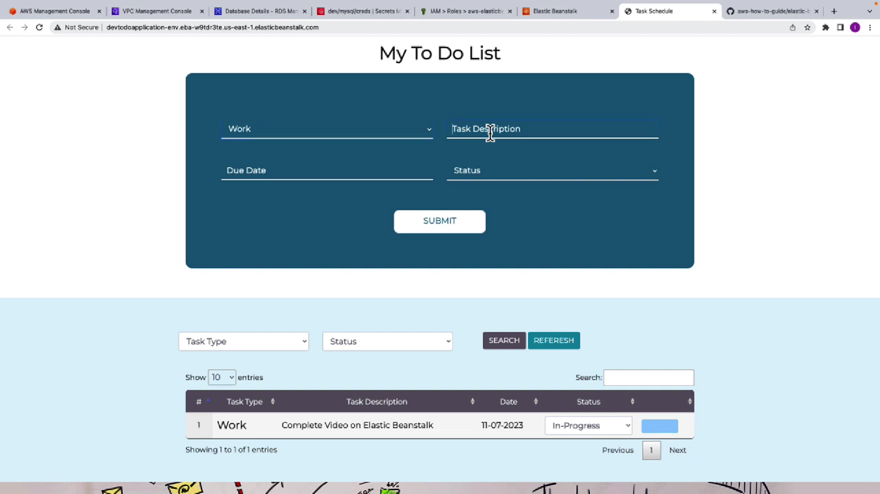
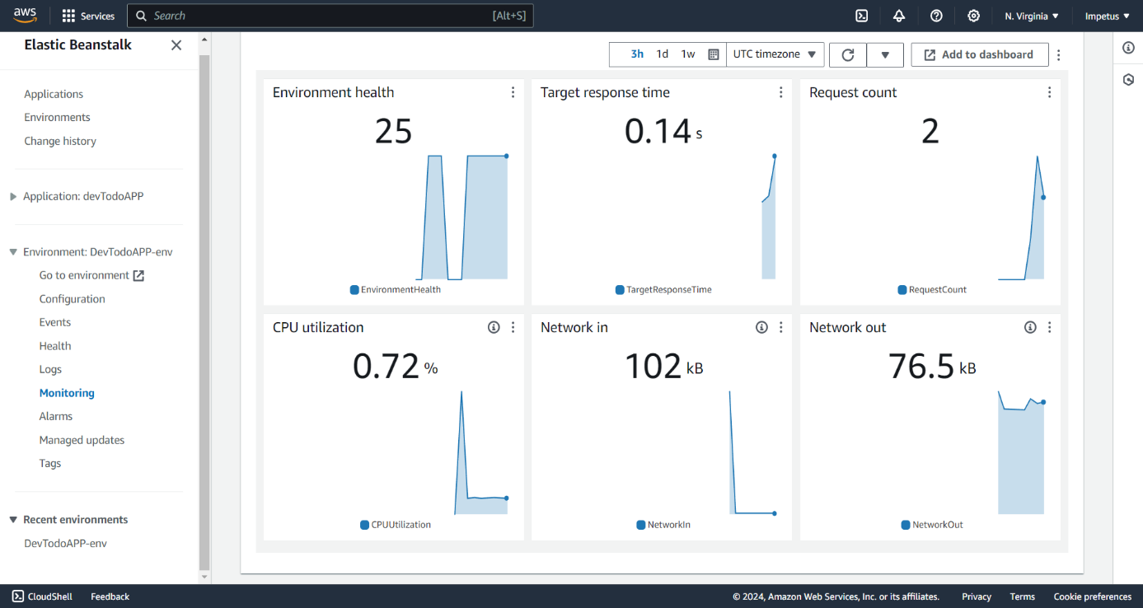
Visualizations
Click For more images
https://drive.google.com/drive/folders/1FIsLAjgrqJPOn7LM3VPO5KDGWp7THpBL?usp=sharing

Slide 14
Organizational Benefits
Enhanced Efficiency: Streamlined workflows reduced manual intervention, saving time for developers and IT teams.
Improved User Experience: Faster response times and high availability led to increased customer satisfaction and retention.
Cost Savings: Optimized infrastructure reduced overall cloud expenditures by 25%.
Scalable Solutions: Enabled the company to handle future growth seamlessly with auto-scaling and dynamic resource allocation.
Knowledge Transfer: Provided the team with detailed documentation and training for continued system improvements.

Slide 15
Learning Experience – New Skills Gained or Developed
Cloud Computing & AWS: Gained hands-on experience with AWS services including EC2, S3, RDS, and Elastic Beanstalk, enhancing cloud infrastructure management skills.
Automation & DevOps: Developed proficiency in setting up CI/CD pipelines using Jenkins and GitLab, leading to a more automated deployment process.
System Optimization: Learned advanced techniques for database query optimization, server load balancing, and resource scaling.
Software Development: Enhanced coding skills through hands-on work with languages and frameworks like JavaScript, Node.js, and Express.js.
Security Best Practices: Gained a deeper understanding of encryption, SSL/TLS protocols, and best practices for securing cloud-based applications.

Slide 16
Professional Growth and Personal Insights
Problem-Solving: Improved problem-solving abilities by troubleshooting complex issues related to system performance, scalability, and deployment.
Project Management: Gained insights into managing timelines, prioritizing tasks, and delivering within deadlines, contributing to more effective project planning.
Collaboration and Communication: Worked closely with cross-functional teams, improving my ability to communicate technical concepts to non-technical stakeholders.
Adaptability: Enhanced flexibility and adaptability in a fast-paced, ever-changing technological environment.
Career Direction: The internship reinforced my interest in pursuing a career in cloud infrastructure management and DevOps engineering.

Slide 17
Challenges Faced During the Internship
Technical Complexity: Understanding and implementing complex cloud infrastructure setups, including AWS services and DevOps tools, presented an initial learning curve.
System Integration Issues: Encountered challenges when integrating new features with existing systems, requiring extensive troubleshooting and debugging.
Time Management: Balancing multiple tasks and deadlines was difficult at times, especially while learning new tools and frameworks on the go.
Collaboration Across Teams: Coordinating with remote teams across different time zones posed communication challenges and required flexibility.
Security and Compliance: Ensuring all systems adhered to the latest security protocols and compliance standards was a continuous challenge, especially with evolving threats.

Slide 18
Future Enhancements and Suggestions
Automation of Deployment Processes: Streamlining the application deployment pipeline with more automated testing and CI/CD integrations to reduce manual intervention and increase efficiency.
Enhanced Security Measures: Implementing advanced security features such as multi-factor authentication (MFA) and real-time anomaly detection to further protect cloud-based resources.
Scalability Improvements: Expanding the auto-scaling configurations to handle a larger volume of traffic and improve load distribution during peak demand times.
Improved User Interface (UI): Focusing on enhancing the UI/UX for better user engagement, making the application more intuitive and user-friendly.
Data Analytics Integration: Incorporating data analytics tools to gather insights from user behavior and system performance to improve decision-making and optimize system resources.
Cross-Platform Compatibility: Ensuring the application is fully responsive across all devices and browsers, improving its accessibility and reach.
AI-Powered Recommendations: Integrating AI-based systems to predict user behavior and personalize the user experience dynamically.

Slide 19
Conclusion
The internship project provided valuable insights into the integration of cloud technologies and modern software development practices. It involved building a scalable, secure web application, leveraging AWS Cloud for seamless deployment and management. The project allowed hands-on experience with DevOps practices, including CI/CD pipelines, infrastructure as code (IaC), and cloud security best practices. Advantages:
Scalability: The cloud-based infrastructure allows the application to scale automatically based on traffic, ensuring optimal performance during peak usage.
Security: Implementing robust security measures such as encryption, access controls, and multi-factor authentication (MFA) ensures data protection and compliance with industry standards.
Efficiency: Automation of deployment and management tasks significantly reduces manual efforts and time, increasing overall efficiency.
Cost-Effectiveness: By leveraging cloud resources and infrastructure-as-a-service (IaaS), the project reduced costs associated with hardware and software management.

Slide 20
Limitations:
Learning Curve: The use of advanced cloud services and DevOps tools required an initial learning curve, which extended the development time.
Complexity: Managing multiple cloud services and ensuring their seamless integration proved to be complex at times, especially when configuring IAM (Identity and Access Management) and monitoring.
Dependency on Internet Connectivity: Since the solution is cloud-based, it is highly dependent on internet connectivity, which may pose challenges in areas with unstable internet access.
Applications:
Business Solutions: The project can be applied to businesses seeking to modernize their IT infrastructure, adopting cloud technologies for more efficient and secure operations.
Scalable Web Applications: This approach can be used for e-commerce platforms, content delivery systems, and enterprise applications that require high availability and security.
Cloud Adoption for Startups: Small and medium enterprises (SMEs) looking to scale their operations without heavy upfront costs can benefit from the cloud-based infrastructure set up in this project.

Slide 21
Significant Outcome(s)
Successful Cloud Deployment: The project led to the successful deployment of a scalable web application using AWS Cloud, ensuring high availability and efficient resource management.
Streamlined Development Process: Through the integration of DevOps practices and CI/CD pipelines, the development and deployment process was significantly streamlined, reducing manual intervention and ensuring faster updates and maintenance.
Enhanced Security Posture: Implementing best practices in cloud security, such as encryption, MFA, and IAM roles, resulted in a robust, secure application environment, safeguarding user data and enhancing compliance with industry standards.
Cost Optimization: By utilizing AWS cloud resources, the project achieved cost savings through the use of serverless computing and pay-as-you-go services, allowing the organization to scale without incurring unnecessary overhead costs.
Real-World Problem Solving: The internship provided real-world exposure to cloud technologies, helping bridge the gap between theoretical knowledge and practical implementation, and enabling the team to deliver a fully functional, production-ready solution.

Slide 22
References
[1] Alharbi, M. H., & Alzahrani, A. M. (2020). Cloud computing security issues and challenges: A survey. Journal of King Saud University - Computer and Information Sciences, 32(3), 237-245. https://doi.org/10.1016/j.jksuci.2018.07.002
[2] Brown, S. A. (2022). The impact of user experience on web application development. International Journal of Human-Computer Interaction, 38(5), 399-415. https://doi.org/10.1080/10447318.2022.2030241
[3] Choudhury, P., & Maiti, J. (2023). A comprehensive review of cloud-based data management systems. Journal of Computer Information Systems, 63(1), 12-20. https://doi.org/10.1080/08874417.2022.2045890
[4] Davis, R., & Jones, T. (2021). Best practices for web application security: A developer'sperspective. Journal of Cybersecurity Technology, 5(2), 145-159. https://doi.org/10.1080/23742917.2020.1792630
[5] Evans, D. (2020). Designing for mobile: Responsive web design and performance. International Journal of Web Engineering and Technology, 15(4), 345-359. https://doi.org/10.1504/IJWET.2020.112568
[6] Fletcher, R., & Mills, J. (2022). A review of machine learning algorithms in cybersecurity applications. Journal of Information Security and Applications, 62, 102890. https://doi.org/10.1016/j.jisa.2021.102890
[7] Gonzalez, R. A. (2023). Trends in cloud architecture: Moving toward microservices. Cloud Computing Journal, 11(2), 78-85. https://doi.org/10.1145/3486590
[8] Harris, L., & Grant, A. (2021). Agile methodologies in web development: A systematic review. Software Engineering Research and Practice, 11(3), 204-217. https://doi.org/10.2139/ssrn.3791234

Slide 23
Q/A
Thank You

